Slide 1
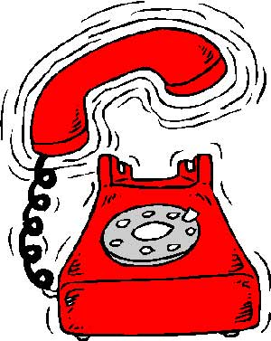
TELEPHONES

Slide 2
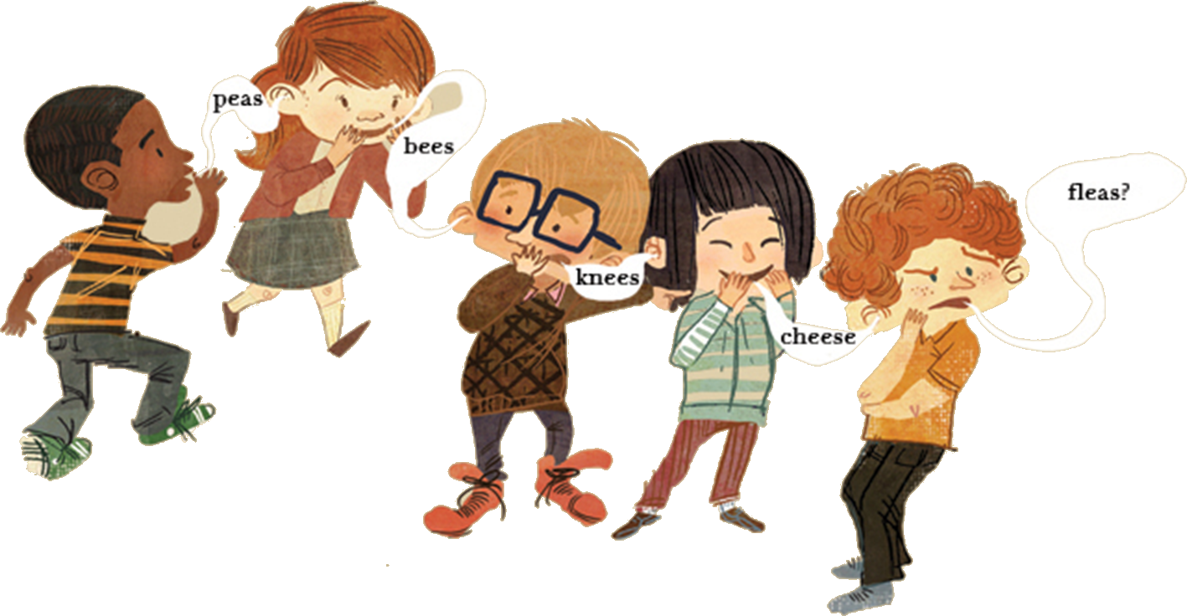
1. Children „sit in a circle“.
2. First child whispers in ear someone else which sit next him the phone message.
3. Other whisper again his neighbor and so on.
4. When the message arrives to the last child, he says this loud.

